Slide 2
The Stables
https://sketchfab.com/3d-models/the-stables-82abdb57429b4074a9b42eb6f74eeb49

Slide 3
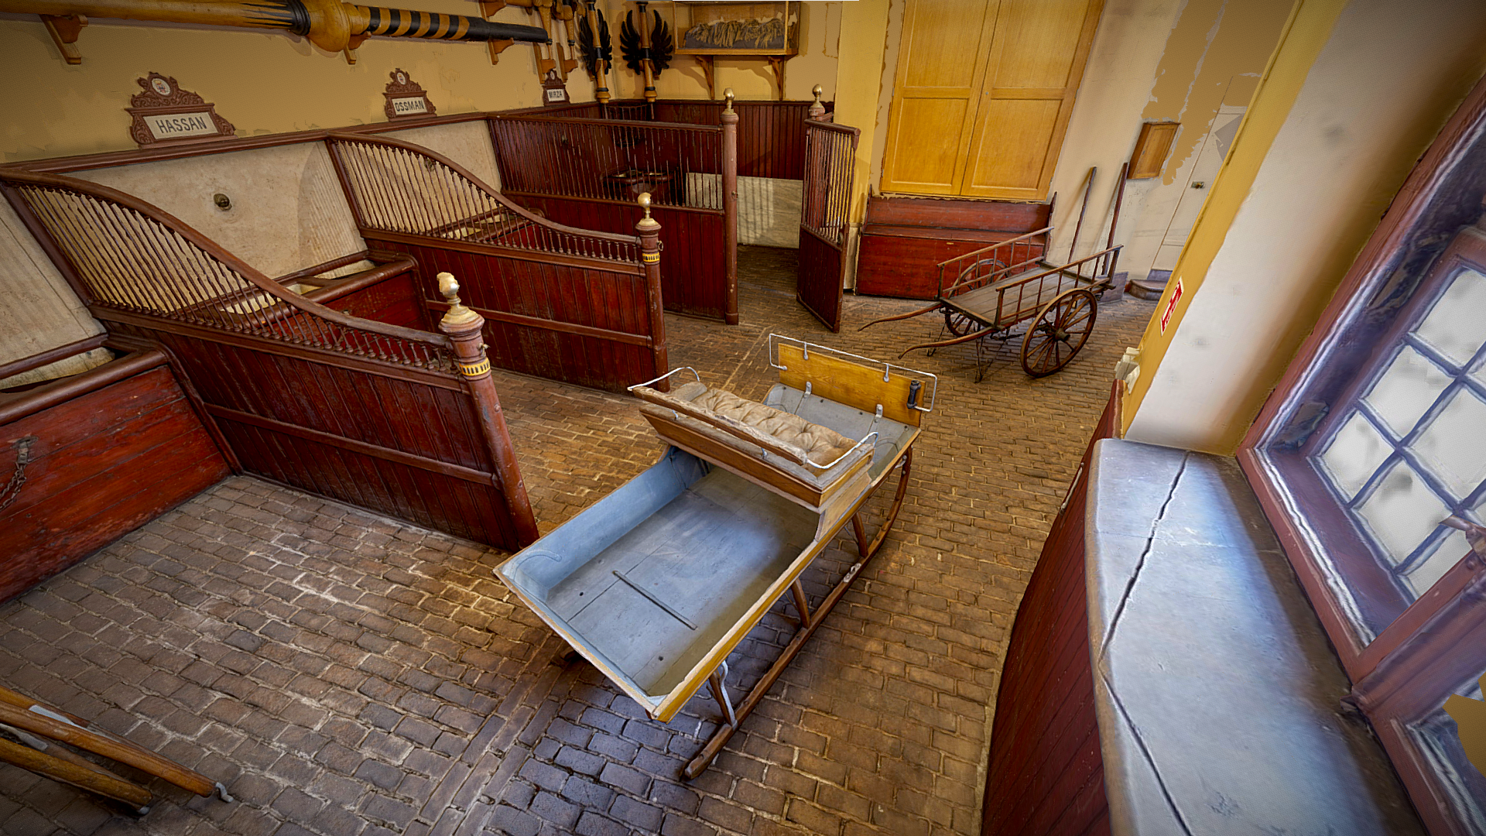

Slide 4
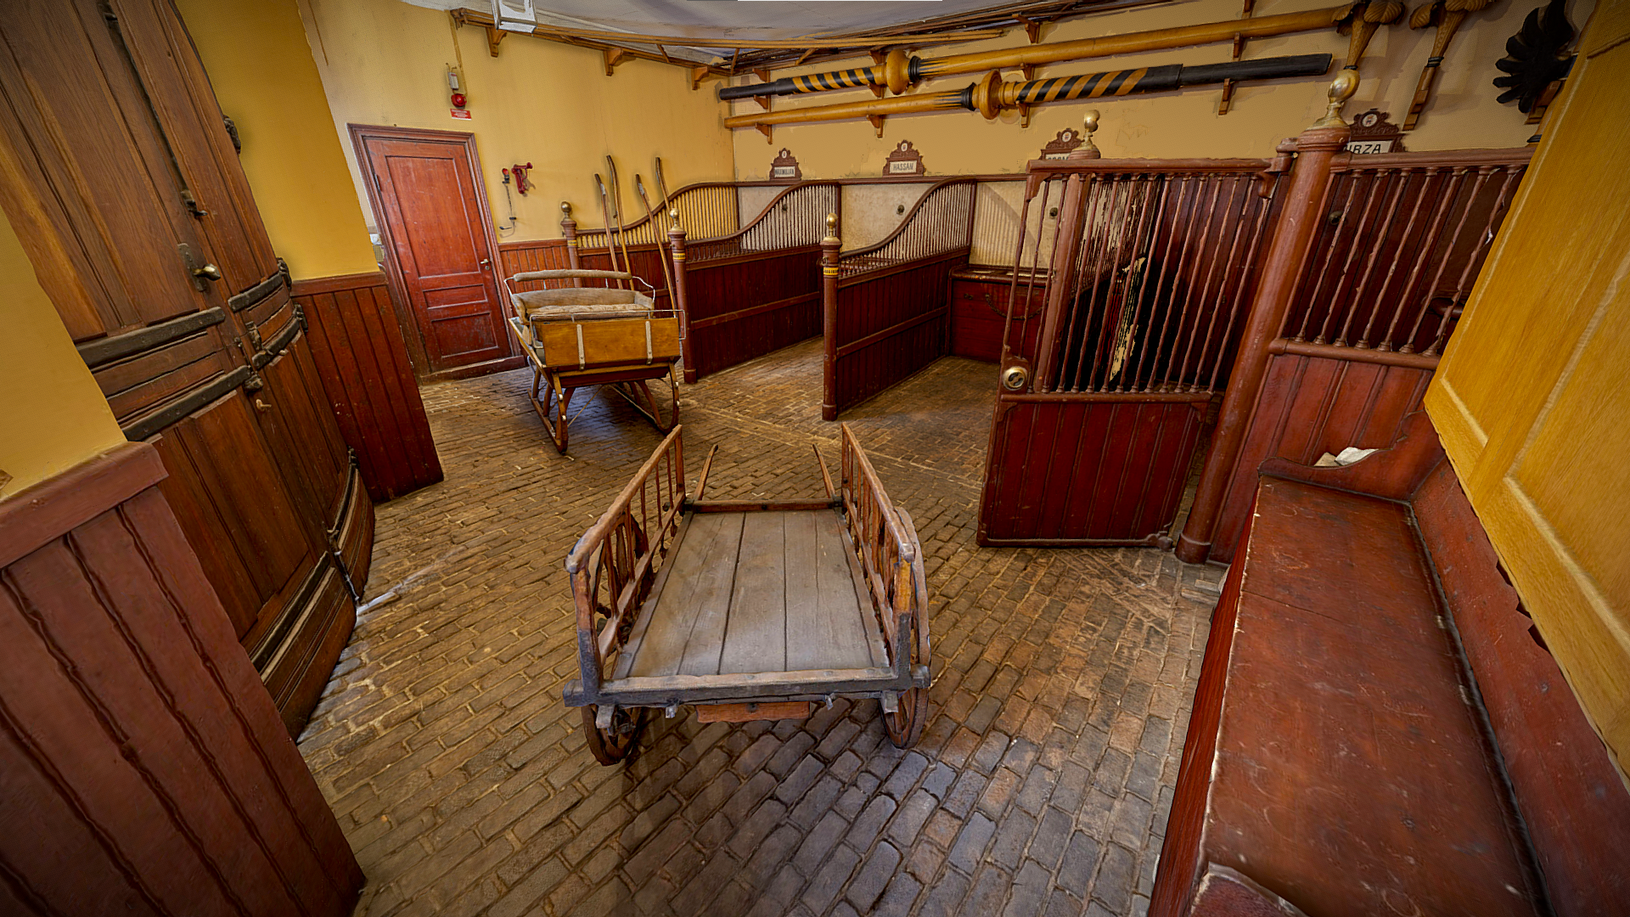

Slide 5
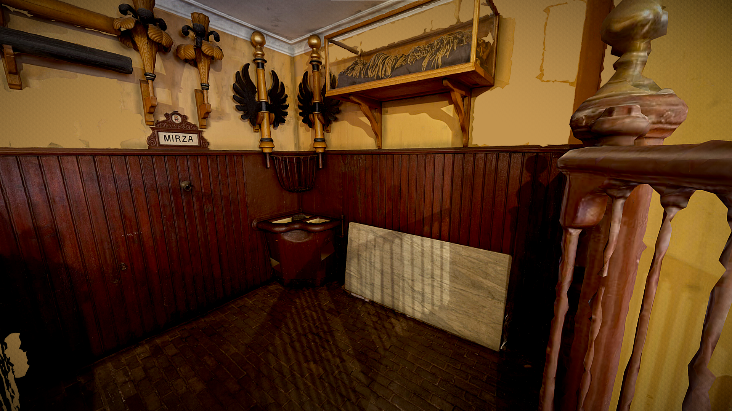

Slide 6
The Armoury
https://sketchfab.com/3d-models/the-armoury-adbe88dcf04d4a87a4c2f62ed6ca0880

Slide 7
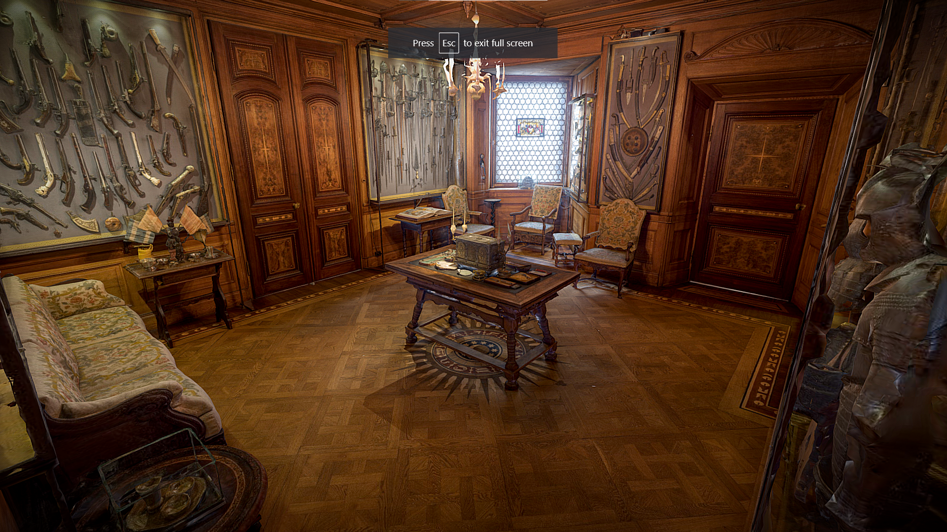

Slide 8
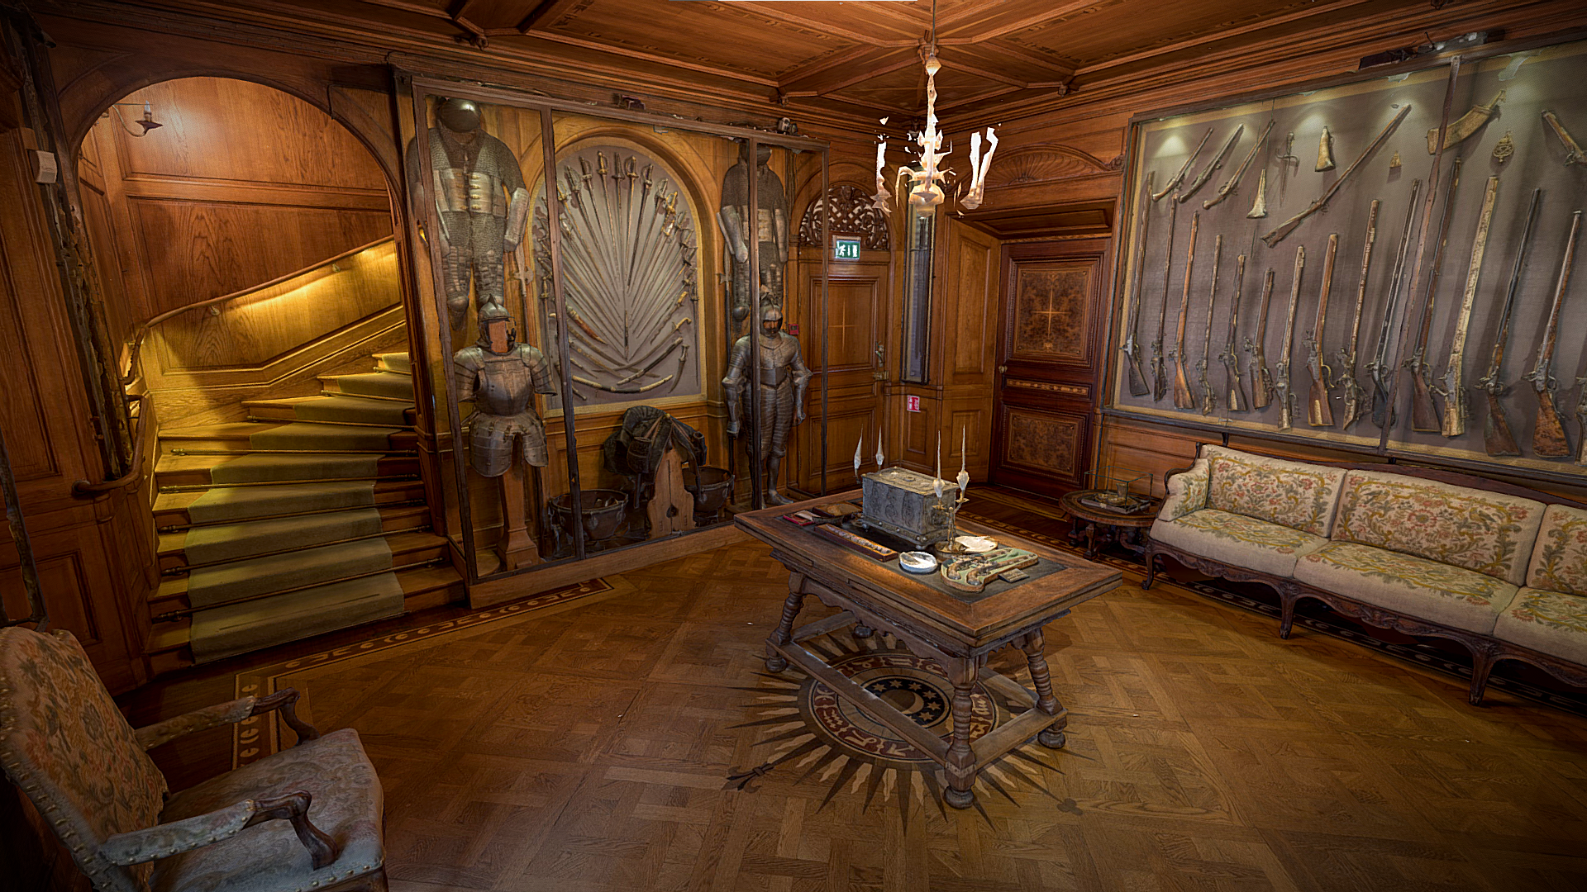

Slide 9
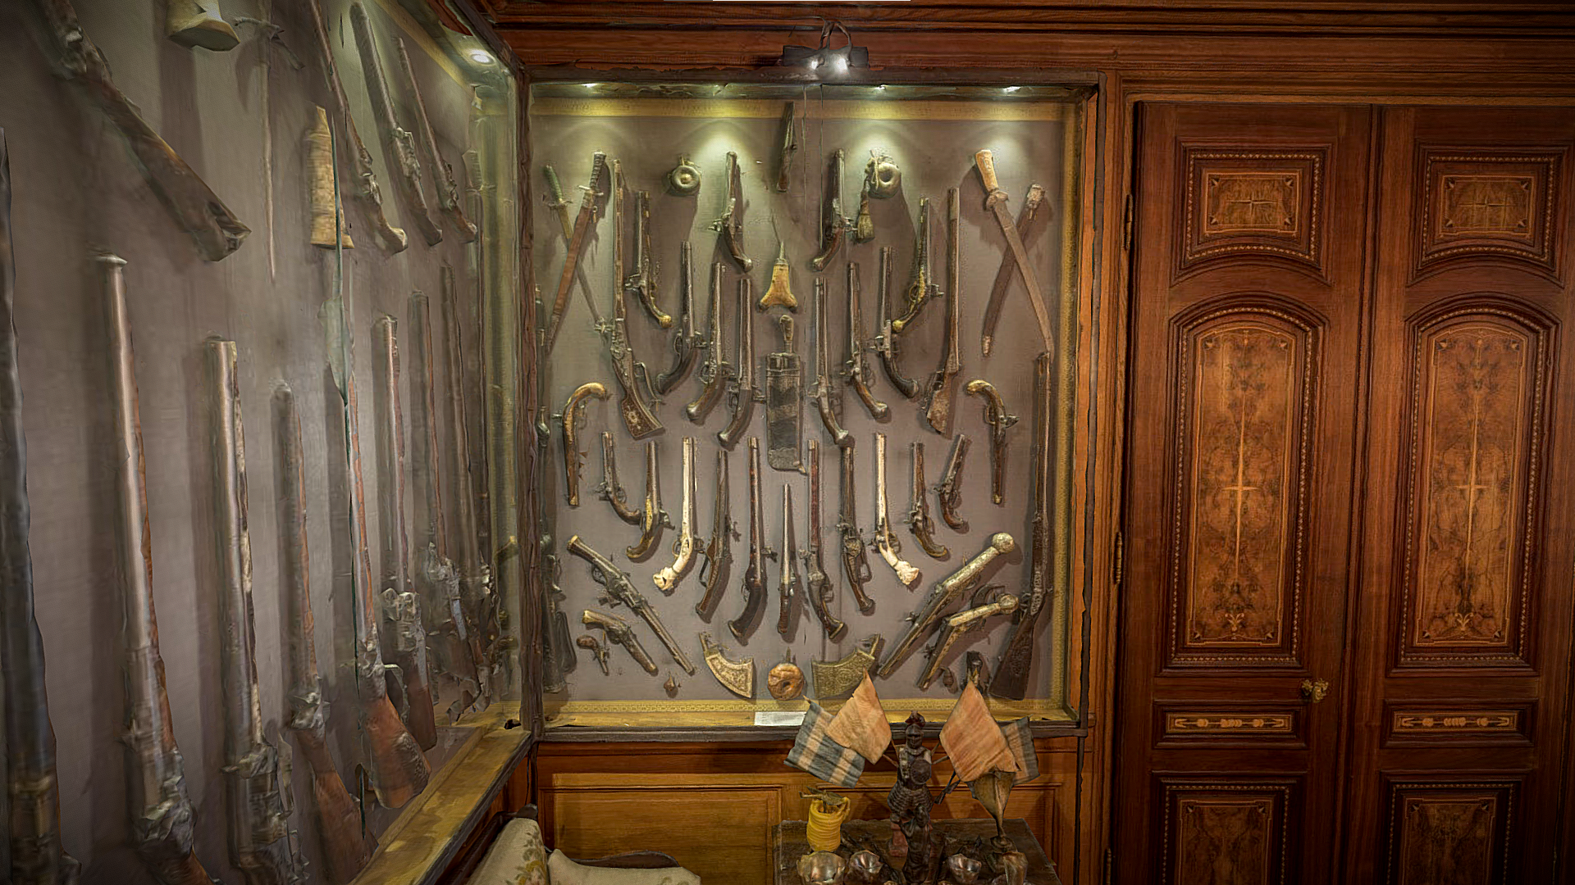

Slide 10
Billiards Room
https://sketchfab.com/3d-models/the-billiards-room-79615d823a9149069dcd06c20bc9707f

Slide 11
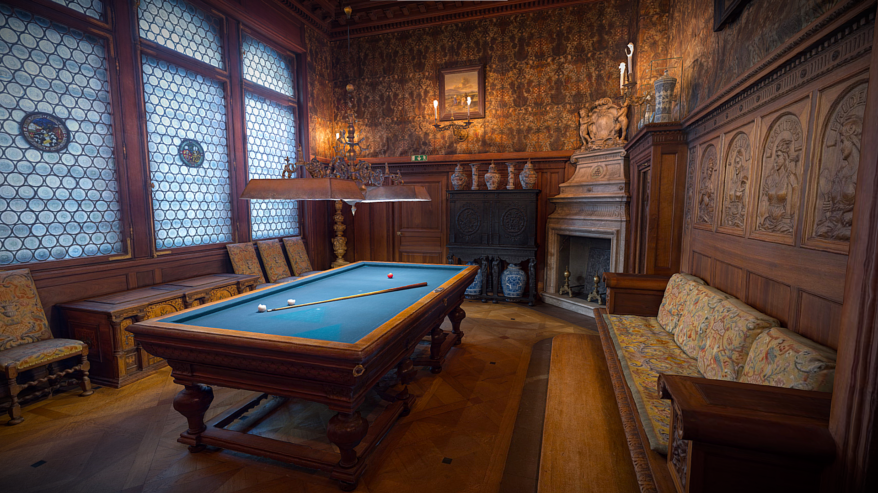

Slide 12
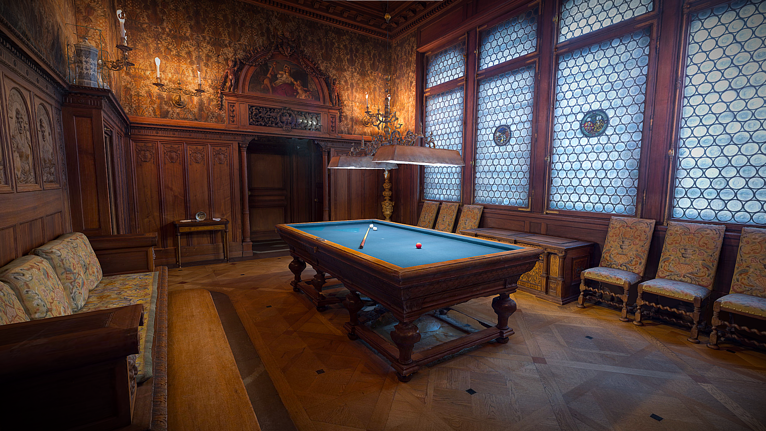

Slide 13
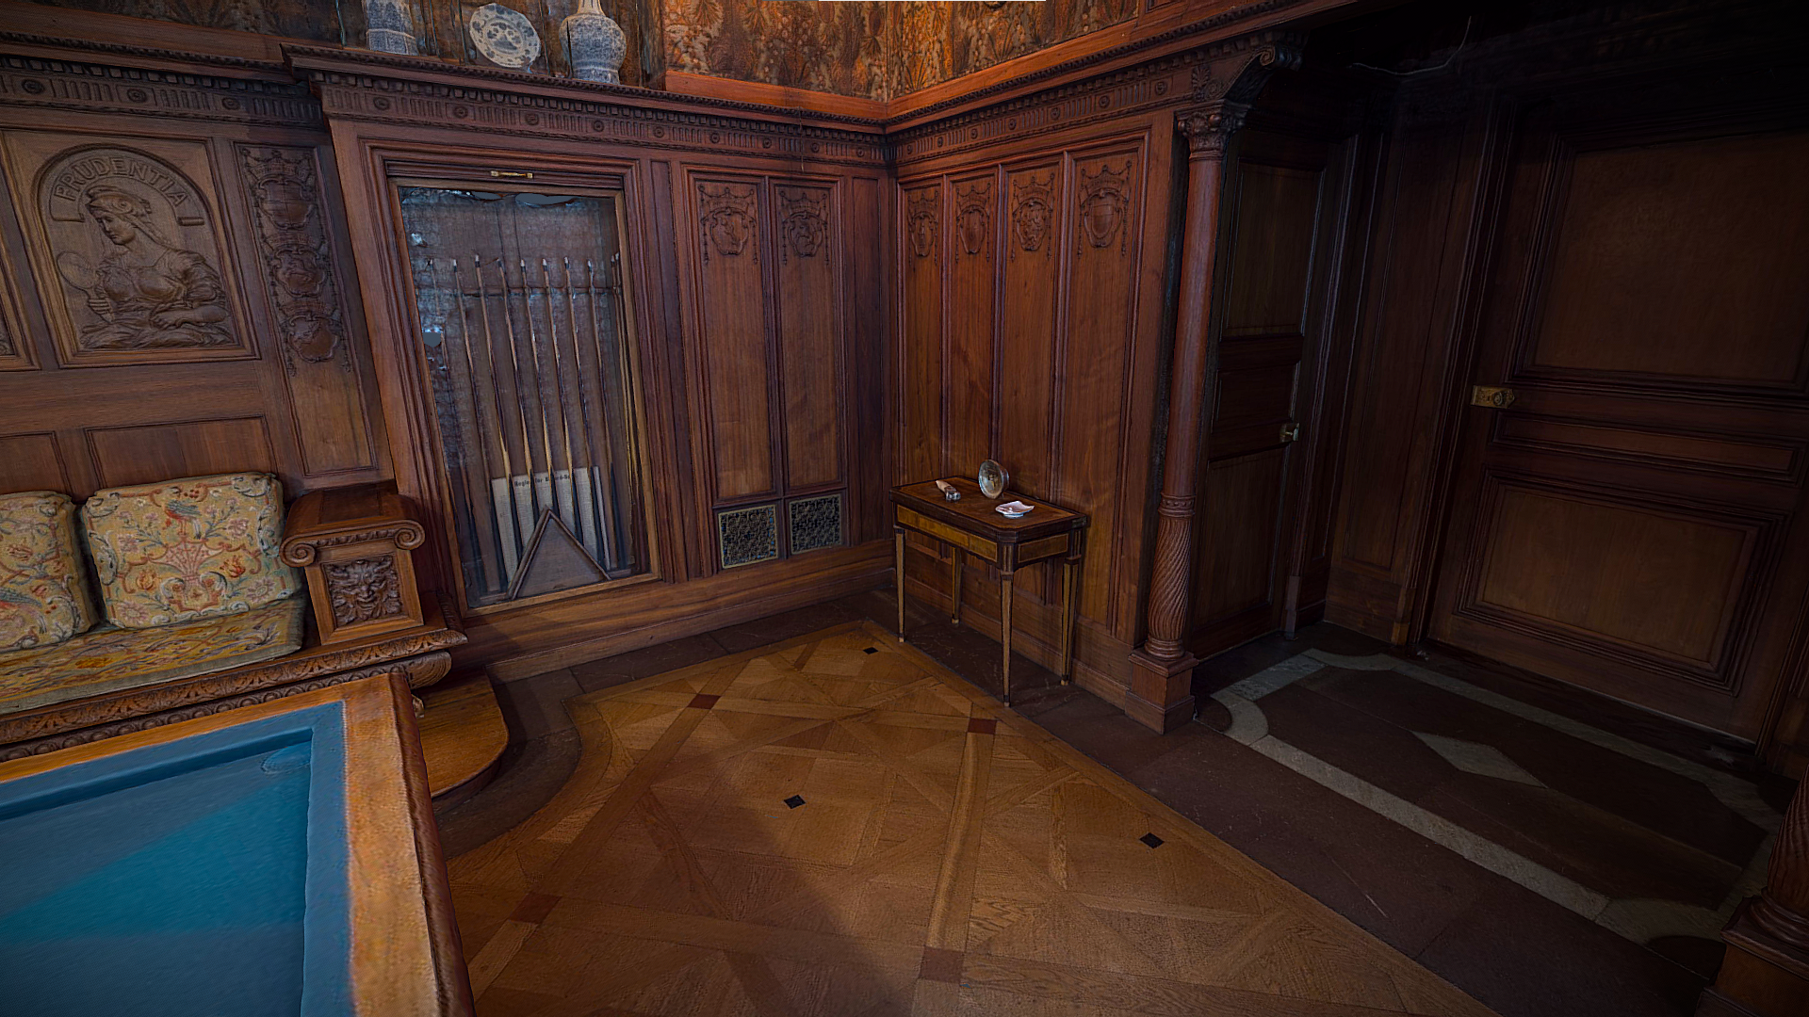

Slide 14
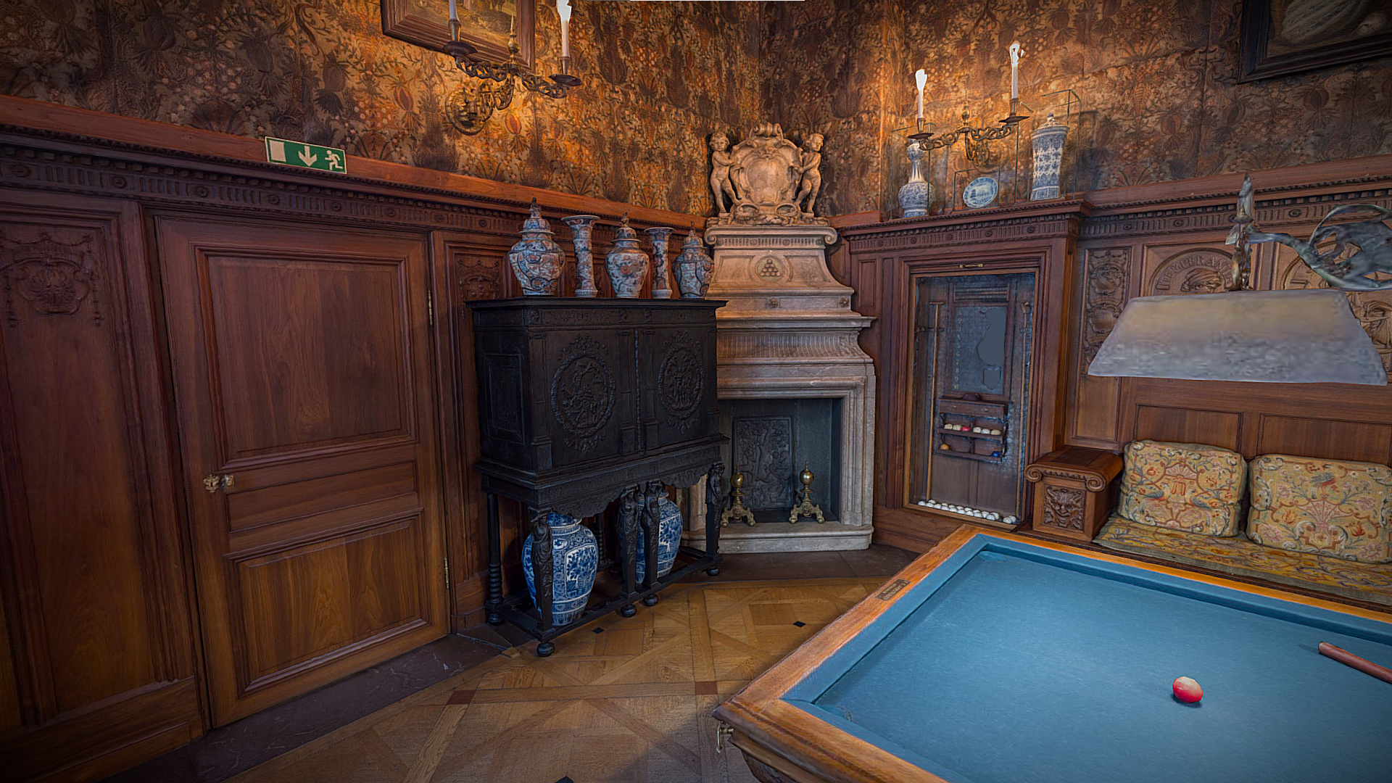

Slide 15
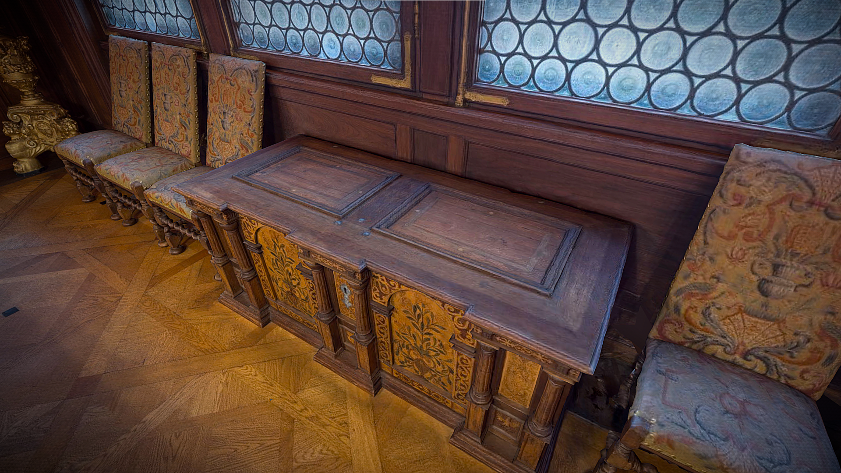

Slide 16
Smoking Room
https://sketchfab.com/3d-models/the-smoking-room-2247ed77976a40b6ae81271cd6b149c8

Slide 17
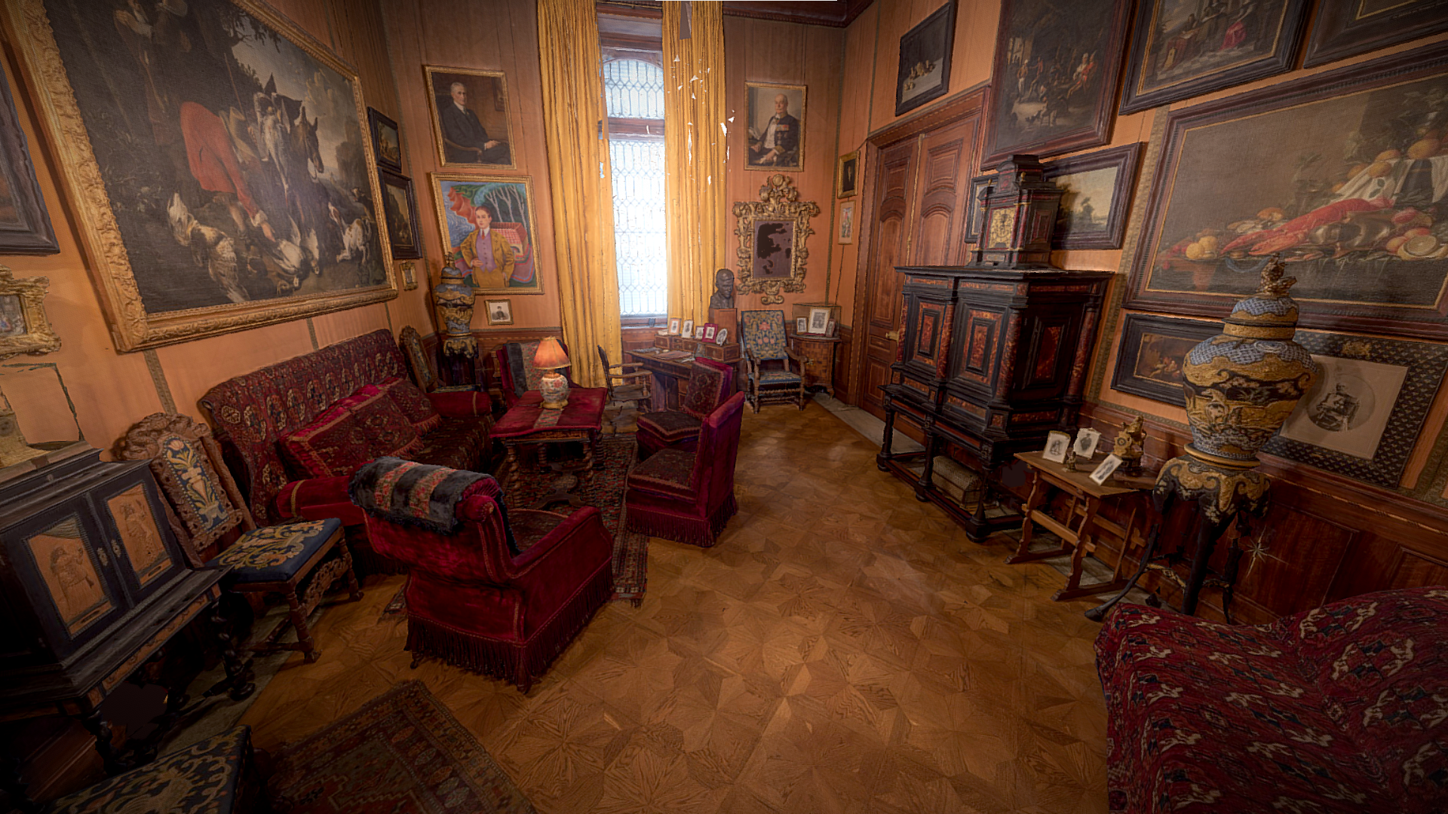

Slide 18
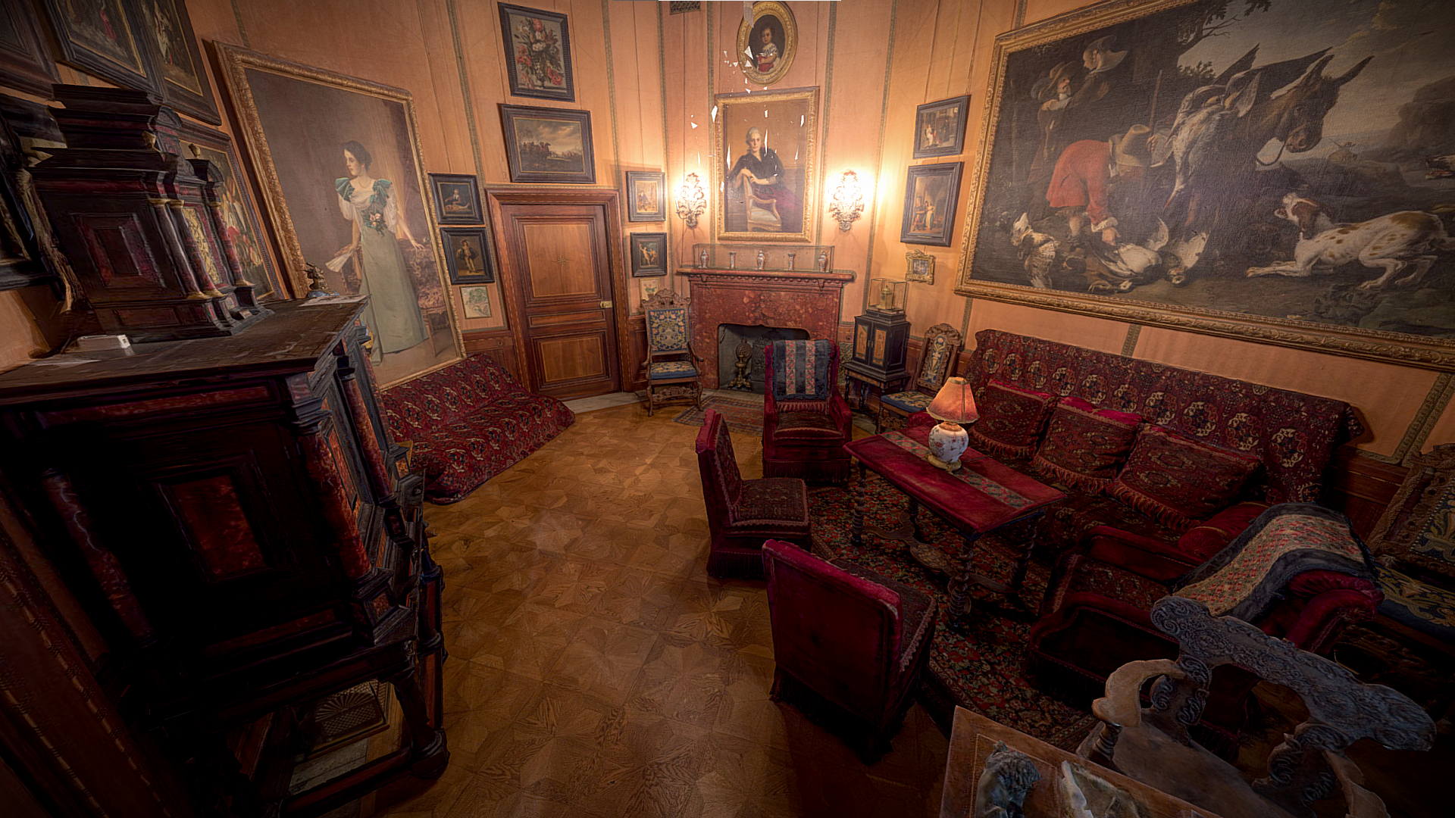

Slide 19
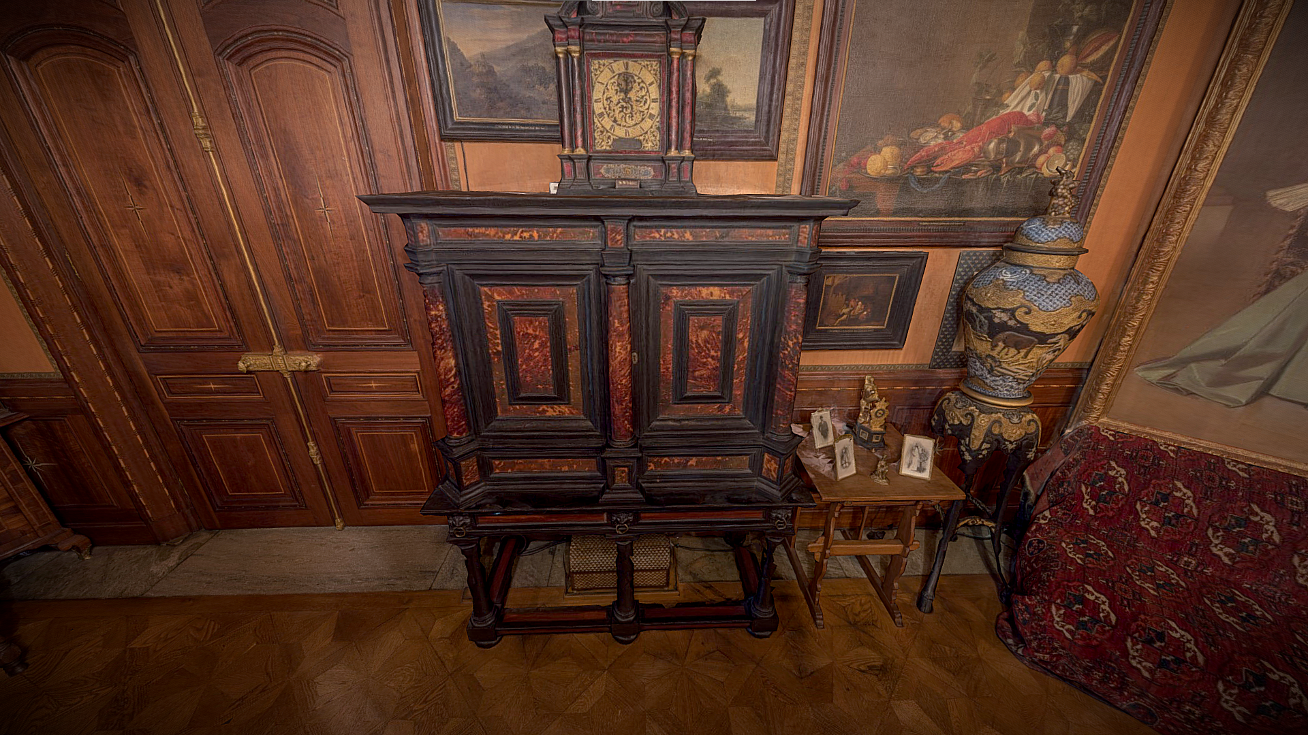

Slide 20
